Slide 1
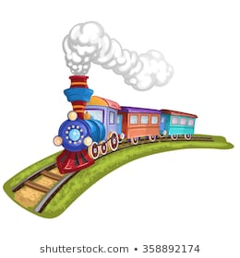
PROBLEM ON TRAINS

Slide 2
CONCEPTAINS
Time taken by a train of length L meters to pass a stationery object of length b meters is the time taken by the train to cover (L + b) meters.
Time taken by a train of length L meters to pass a pole or standing man or a signal post = time taken by the train to cover L meters.
Here "a pole or standing man or a signal post" means object with Zero length

Slide 3
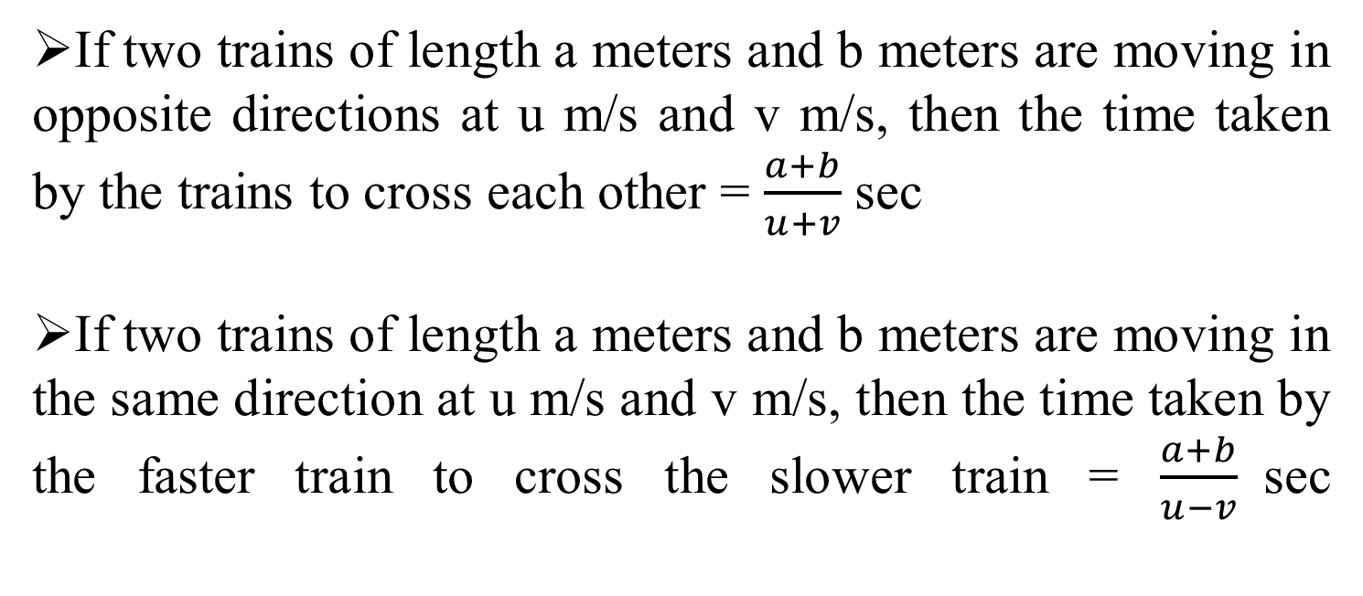
If two trains of length a meters and b meters are moving in opposite directions at u m/s and v m/s, then the time taken by the trains to cross each other = $\frac{a+b}{u+v}$ sec
If two trains of length a meters and b meters are moving in the same direction at u m/s and v m/s, then the time taken by the faster train to cross the slower train = $\frac{a+b}{u−v}$sec

Slide 4
Examples
Ex 1. A train 100 m long is running at the speed of 30 km/hr. Find the time taken by it to pass a man standing near the railway line.
A.10 sec B. 12 sec C.15 sec D.11 sec
Ex 2. A train is moving at a speed of 132 km/hr. If the length of the train is 110 metres, how long will it take to cross a railway platform 165 metres long?
A. 7.5 sec B. 8 sec C. 9 sec D. 10 sec
Notes:
Speed of the train = (30 × 5/18) m/sec = (25/3) m/sec.
Distance moved in passing the standing man = 100 m.
Required time taken = 100/(25/3) = (100 × (3/25)) sec = 12 sec

Slide 5
Q 3. A man sitting in a train which is travelling at 50 kmph observes that a goods train, travelling in opposite direction, takes 9 seconds to pass him. If the goods train is 280 m long, find its speed?
A. 80 km/h B. 62 km/h C. 70 km/h D.75 km/h
Answer: B
Q 4. A man is standing on a railway bridge which is 180 m long. He finds that a train crosses the bridge in 20 seconds but himself in 8 seconds. Find the length of the train and its speed.
A. 54 km/h B.50 km/h C. 51 km/h D.53 km/h
Answer: A
Notes:
3.Relative speed = 280/9 m / sec = ((280/9) × (18/5)) kmph = 112 kmph.
Speed of goods train = (112 - 50) kmph = 62 kmph.

Slide 6
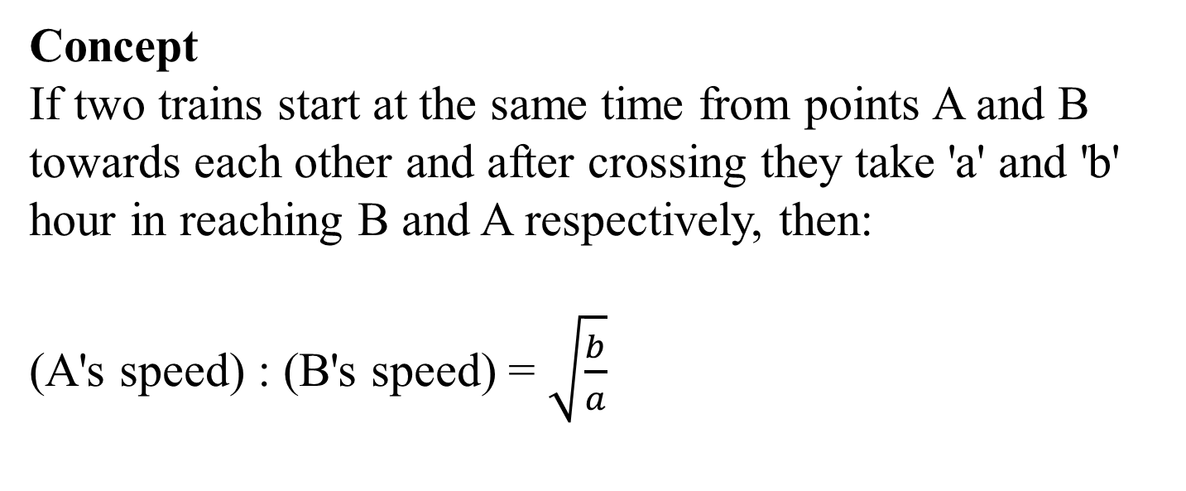
Concept
If two trains start at the same time from points A and B towards each other and after crossing they take 'a' and 'b' hour in reaching B and A respectively, then:
(A's speed) : (B's speed) = $\sqrt{\frac{b}{a}}$

Slide 7
Example: Two trains start at the same time from points x and y towards each other and after crossing, they take 9 h and 4 h in reaching points y and x, respectively. Find the ratio of speeds of the 1st train to that of the 2nd train. A. 2:3 B. 3:2 C. 2:5 D. 5:3 Answer: A
Notes:
T1=9h and T2=4h According to the formula, (1st train's speed) : (2nd train's speed) =√4–√9:= 2 : 3

Slide 8
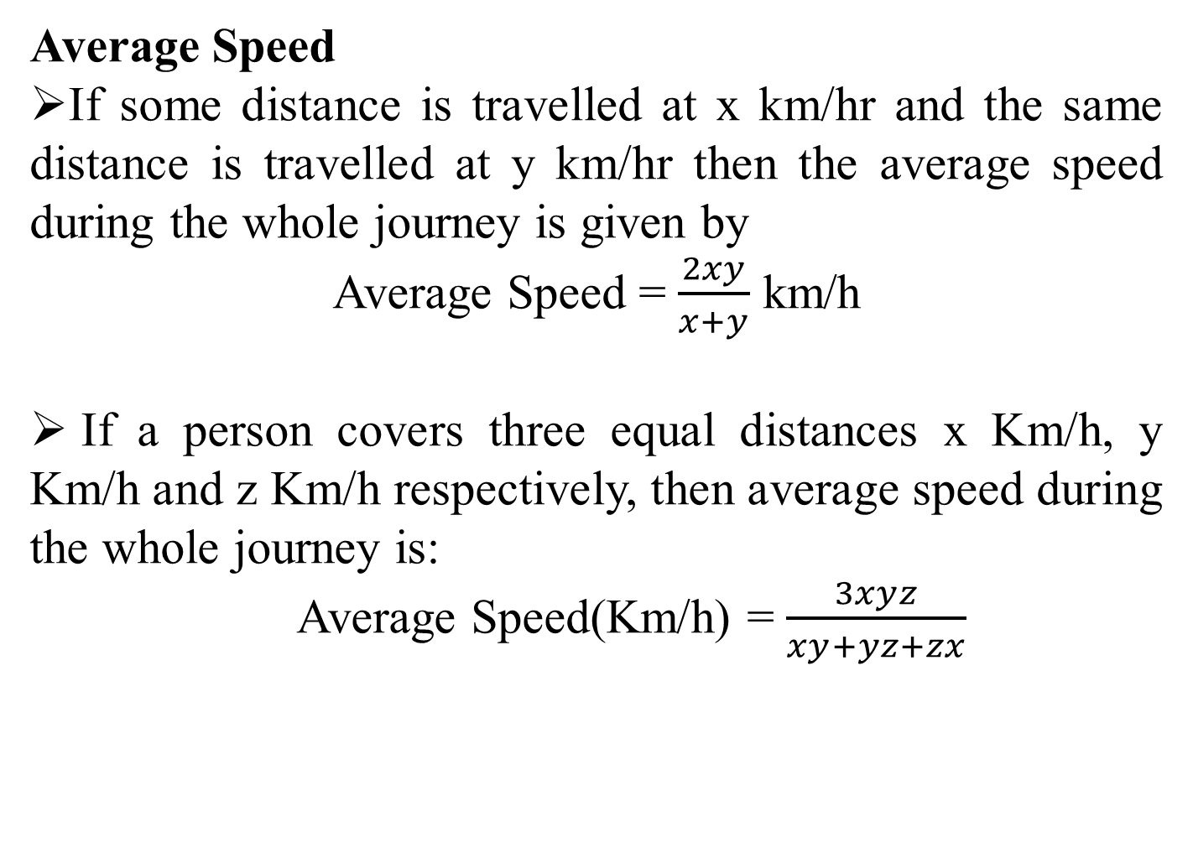
Average Speed
If some distance is travelled at x km/hr and the same distance is travelled at y km/hr then the average speed during the whole journey is given by
Average Speed = $\frac{2xy}{x+y}$ km/h
If a person covers three equal distances x Km/h, y Km/h and z Km/h respectively, then average speed during the whole journey is:
Average Speed(Km/h) = $\frac{3xyz}{xy+yz+zx}$

Slide 9
Practice Questions
1. A train 220 m long is running with a speed of 59 kmph. In what time will it pass a man who is running at 7 kmph in the direction opposite to that in which the train is going?
A. 110m B.120m C. 130m D. 140m
Answer: D
2. A man sitting in a train which is travelling at 50 kmph observes that a goods train, travelling in opposite direction, takes 9 seconds to pass him. If the goods train is 150 m long, find its speed.
A. 20 km/h B. 30 km/h C. 10 km/h d. 40 km/h
Answer: C
Notes:
Speed of the train relative to man = (59 + 7) kmph
= (66 × 5/18 ) m/sec = ( 55/3) m/sec.
Time taken by the train to cross the man
:. (x + y)/15 = 20
= x + y = 300
= y = (300 – 160) m = 140m.
:. Length of the platform = 140 m.

Slide 10
3. A man sitting in a train which is travelling at 50 kmph observes that a goods train, travelling in opposite direction, takes 9 seconds to pass him. If the goods train is 150 m long, find its speed.
A. 20 km/h B. 30 km/h C. 10 km/h d. 40 km/h
Answer: C
4. A train running at a speed of 40 m/s crosses a pole in 21 seconds less than the time it required to cross a bridge 3.5 times its length at the same speed. What is the length of bridge?
A. 1080 m B. 240 m C. 840 m D. 560 m
E. None of these
Answer: C
Notes:
Relative speed = (150/9) m/sec =(150/9 × 18/5) kmph = 60 kmph.
:. Speed of goods train = (60 - 50) kmph = 10 kmph.

Slide 11
5. The ratio between the speed of bike and train is 15 : 27 respectively. Also, a bus cover a distance of 720 km in 9 hours. The speed of the bike is three fourth the speed of bus how much distance will the train cover in 7 hours?
A. 756 km B. 760 km C. 740 km D. CND
E. None of these
Answer: A
6. Two train A and B start at the same time from Delhi and Patna respectively towards each other they met after 16 hours. If the distance between Delhi and Patna is 1872 km and train B runs 27 km/h faster than train A what is the speed of train A?
A. 45 km/h B. 72 km/h C. 48 km/h D. 60 km/h
E. None of these
Answer: A

Slide 12
7. Two stations P and Q are 110 km apart on a straight track. One train starts from P at 7 a.m. and travels towards Q at 20 kmph. Another train starts from Q at 8 a.m. and travels towards P at a speed of 25 kmph. At what time will they meet? A. 11:00 a.m. B. 09:00 a.m. C. 10:00 a.m. D. 09:10 a.m.
Answer: C

Slide 13


